Slide 1
Data Warehousing SS ZG515
PC Reddy
Guest Faculty – WILP, BITS Pilani

Slide 2
Data Warehousing – Lecture 15
SAP BI
Example: DW Database Flow

Slide 3
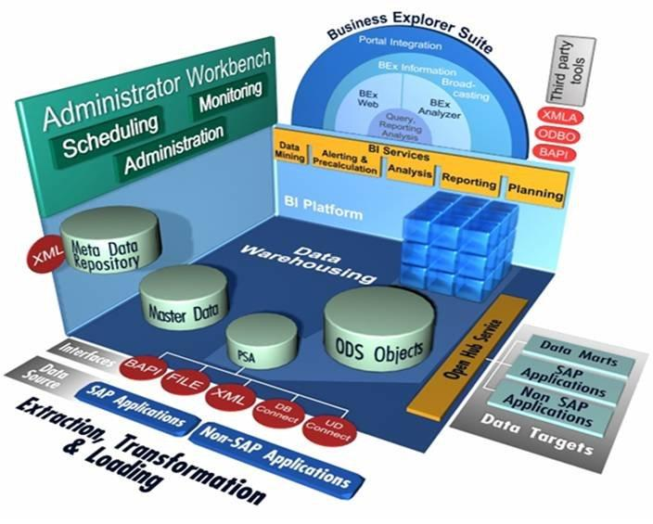
SAP Business Intelligence (BI)

Slide 4
Confirm
SAPGUI Installation
Menu path
Start All Programs SAP Front End SAP Logon

Slide 5
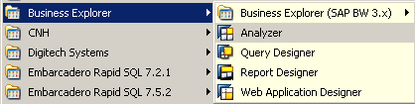
Confirm
Bex Analyzer Installation
Start All Programs Business Explorer Analyzer

Slide 6
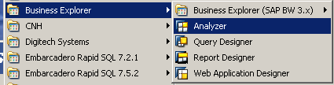

Initiate the Analyzer Add-In to access the query
Follow the below menu path
Start All Programs Business Explorer Analyzer
A session of Excel 2007 will open, with the Analyzer Toolbar in ‘Add-ins’
6

Slide 7
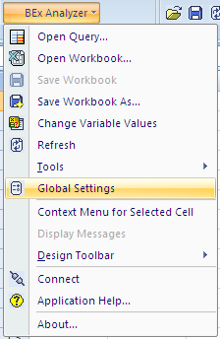
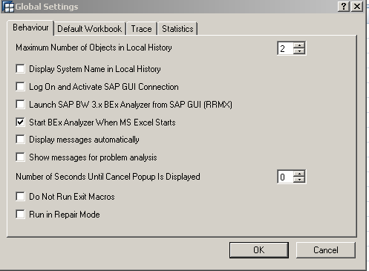
Permanently attach the add-in - optional
The Add-in does not automatically start with a session of Excel, but a setting can be changed for that.
7

Slide 8
Cube Sources
Legacy Systems
Select
History
CUBE
SD
FI-AP
Σ
FI - GL
MM
FI-AR
CO - PA
AA
8

Slide 9
Scope …(cont.)
Synthesis of an accounting and data string.
FI – GL Specific Fields
Legacy Specific Fields
9

Slide 10
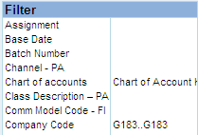
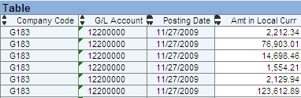
Query Frame
The Query itself will be broken into two main sections from where manipulation and navigation will be done, much like a Pivottable.
A ‘Filter’ area. Available fields. A ‘Live’ area for further selecting.
A ‘Table’ area. Results. Also a ‘live’ area.
Filter Area
Results Area
10

Slide 11
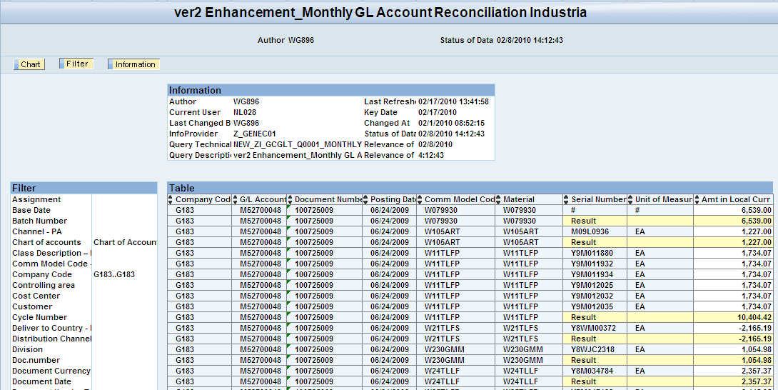
Query Frame
11

Slide 12
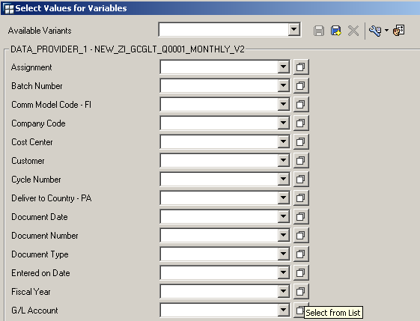
Execute: Select ‘Variables’
Whenever you first run a query, a ‘Variables’ screen (selection critera) may appear for those fields defined in the query against a given CUBE.
Select what you want to query upon here…you will be prompted by this screen when you first open the query.
12

Slide 13
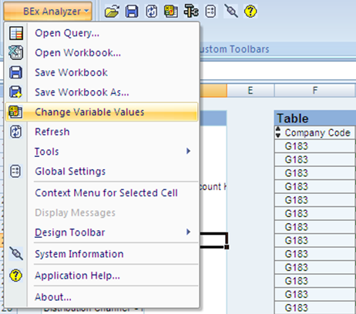
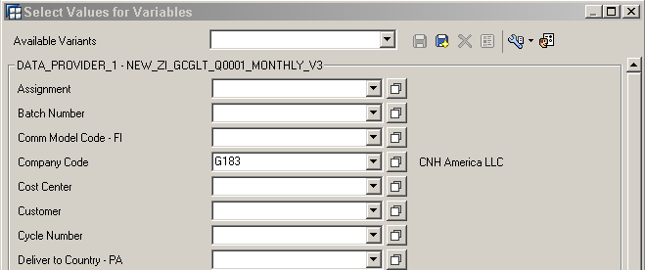
Changing ‘Variables’ From Within an active query
To start a new query, modify the ‘variables’ / ‘Selections’
Use the Drop Down menu or Icon ‘Change Variables’.
A new ‘Variables’ window appears. Modify or make entirely new selections, and a new query will run…
13

Slide 14
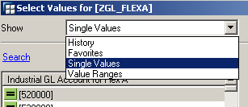
Options of Selection: ‘Variables’
Options of Selection :
Single values
Range of values (from/to)
Favorites
History
Selection Options of note:
Include value(s)
Exclude value(s)
Between
Greater than Less than etc.
Contains Pattern (Wild Cards)
In the tab of selection of the data, the icon: allows you to make a multiple selection. It is activated with variable filters.
14

Slide 15
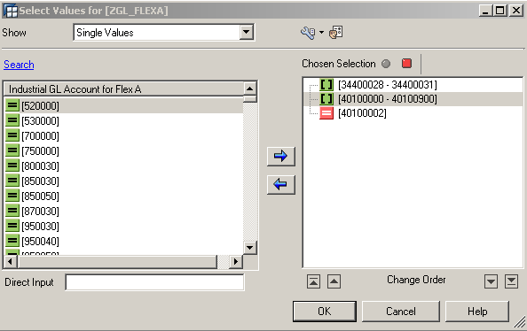
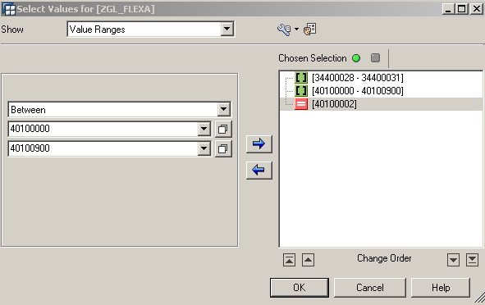
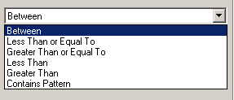
Data can be selected for several Single values, or a range of values. It can also be used to exclude one or more Single values, or a range of values.
Contains Pattern… or WildCards!
15

Slide 16
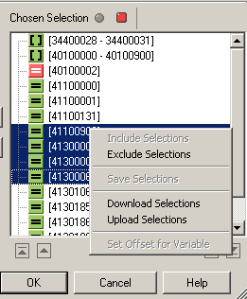
Options of Selecting: Features
The right hand section of ‘selections’ allows you to:
Make Inclusions or Exclusions via the Red and Green Toggle or the Right Click menu
Upload a large list of selections from a .txt file (* this simulates the ‘paste from clipboard’ in SAP R/3 . Use Upload for ‘Mass Selecting’.)
You CAN paste from Clipboard via Control + V even though, there is no shortcut for the Mouse
16

Slide 17
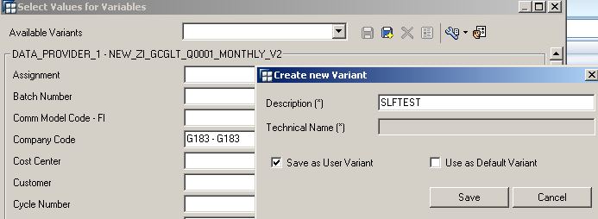
Save Variant
When setting variables, you can pre-set the filters from the launch of the query in a Variant.
You can then recall your pre-saved variables from your Variants.
17

Slide 18

Recall Variant
In the future, when opening the query, the Variant with the pre-selections will be in your dropdown.
18

Slide 19
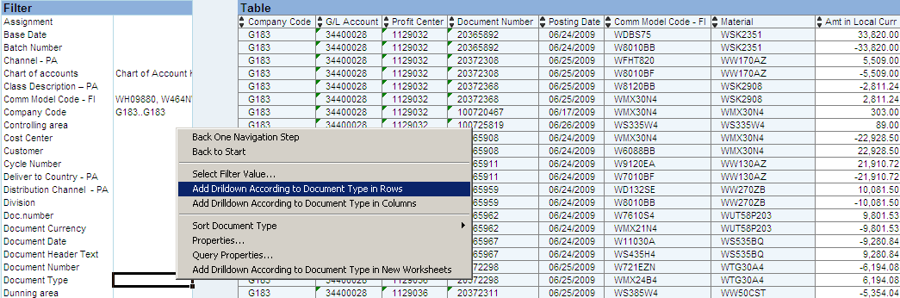
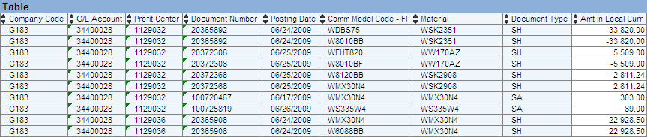
BEx Analyzer – Drill Down
Right Click menu
19

Slide 20
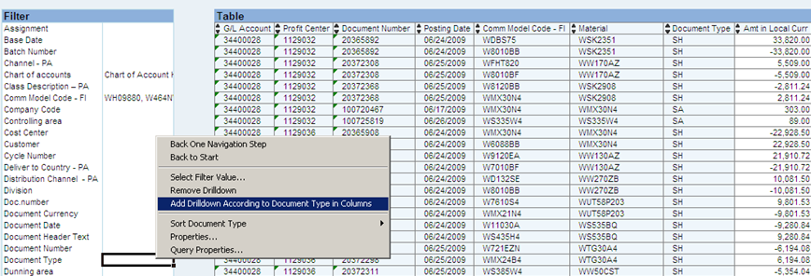
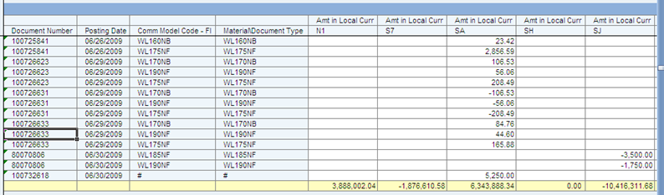
BEx Analyzer – Drill Across
Right Click menu
20

Slide 21
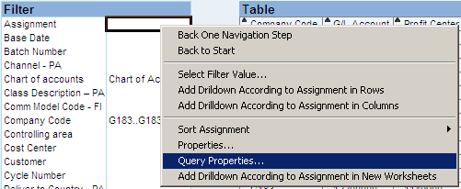
Drilling: Alternate Method
‘Query Properties’ is the most powerful function to manipulate the Query
Specifically, manipulating multiple Drill Down and Drill Across selections simultaneously.
21

Slide 22
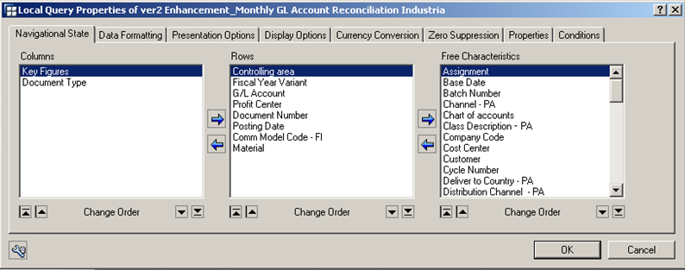
Drill via ‘Query Properties’
NOTICE
Similar to a ‘Pivottable’.
The ‘Free Characteristics’ are the fields from the ‘filter area’ whose values you may wish to return by adding to the Rows or Columns which can be done in multiples here.
22

Slide 23
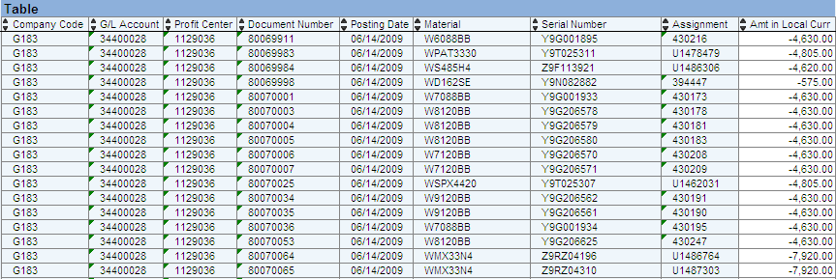
‘Query Properties’ (cont.)
Serial Number and Assignment can now be seen in the results
23

Slide 24
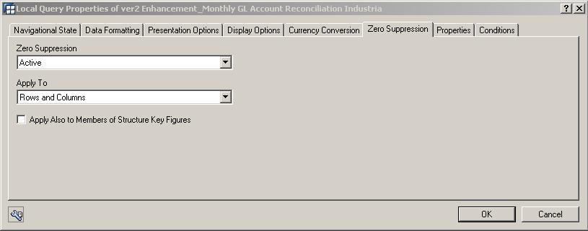
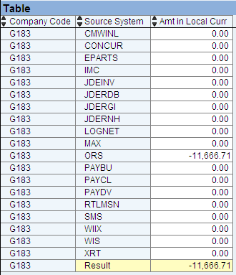
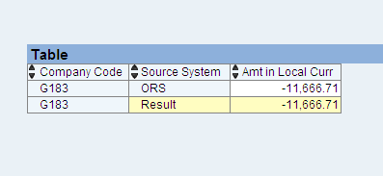
Query Properties To zero or not to zero…Zero Suppression
SUPPRESS
Do not suppress
24

Slide 25
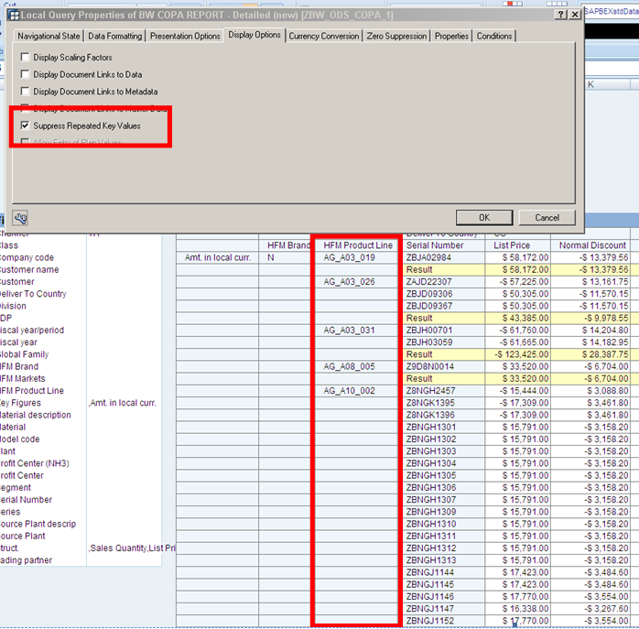
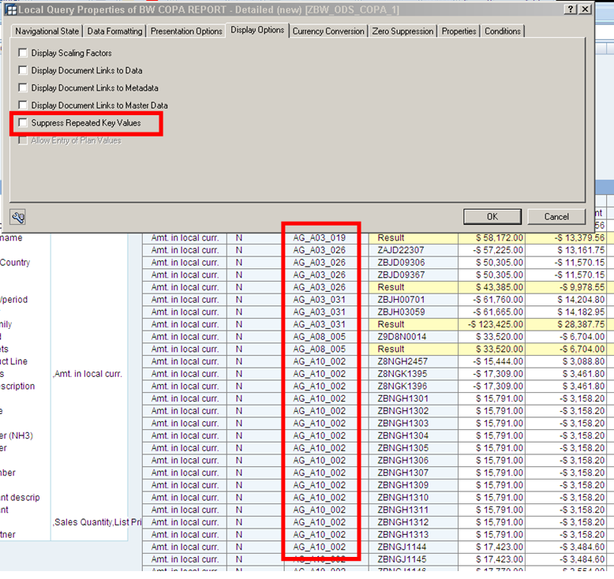
Query Properties – Display Options Suppress Repeated Key Values
Like an Excel Pivottable, a filed will show data in a first instance of a series
Unlike excel pivottables, this can be converted to look like a true list, whish is usefule for vlookups

Slide 26
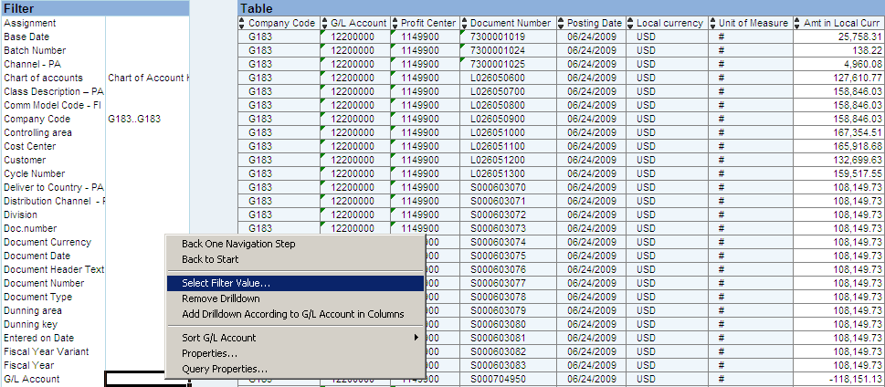
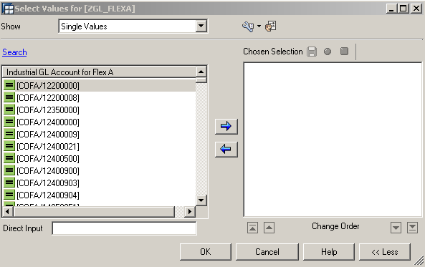
BEx Analyzer – Select Filter
If you decide to further narrow your selection, you can filter from within the query.
26

Slide 27
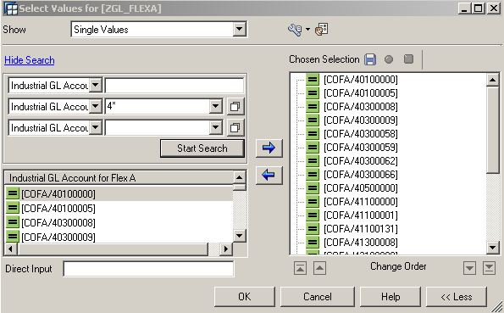
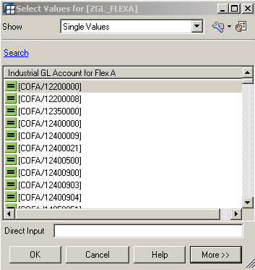
BEx Analyzer – Manage Select Filter
‘Search’ for values, and use wild cards, such as ‘account like 4*’. Returns all accounts begining with ‘4’.
27

Slide 28
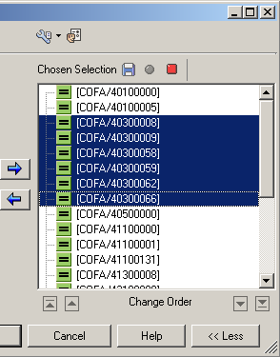
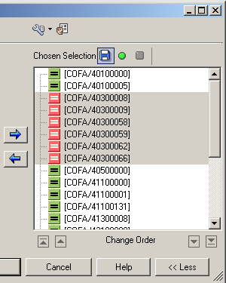
BEx Analyzer – Manage Select Filter
If you would like all ‘4*’ accounts except those that begin ‘403’ (Disc), you can ‘Exclude’. Highlight, and click ‘Exclude’ to Gross the query up.
28

Slide 29
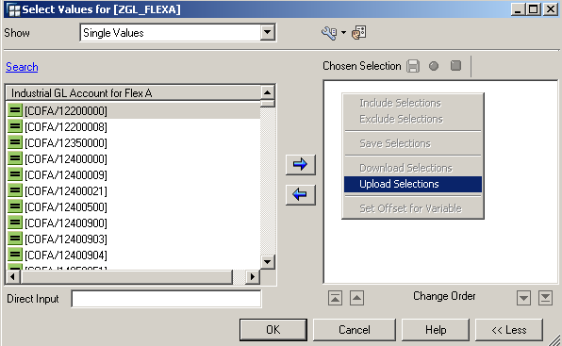
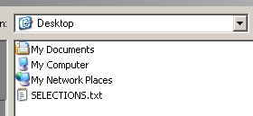
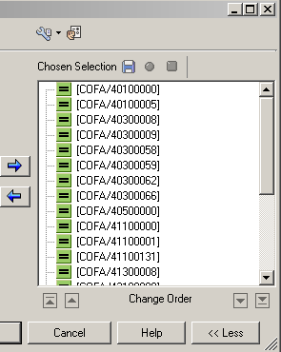
BEx Analyzer – Manage Select Filter – Upload Selections
If you have a large number of varied selections, you can upload a list from a .txt file, or Ctrl+V
29

Slide 30
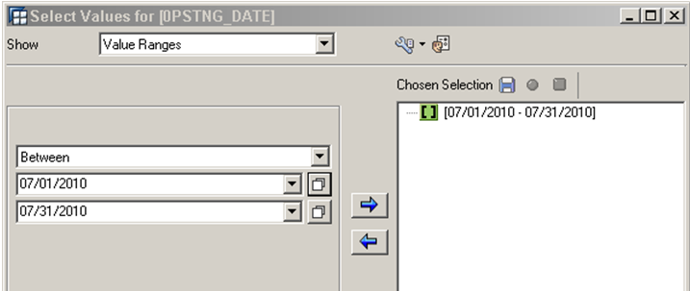
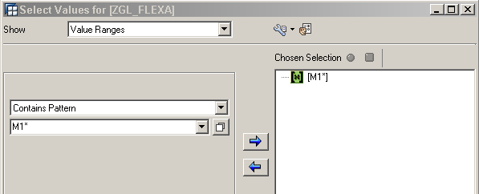
BEx Analyzer – Ranges (and ‘Contains Pattern’ Wild-Card)
30

Slide 31
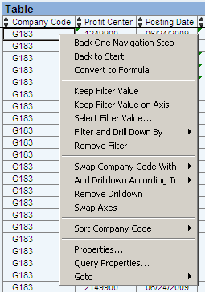
Features of ‘Table’
Right Click Menu any place within the ‘table’ section to see some of the features.
‘Swap…with’ to quickly change out one field with another
‘Swap Axes’ will transpose the Rows & Columns
‘Properties’ (individual field)
‘Query Properties’ (layout)
‘Select Filter’ (within the query results, ie, query down a level)
‘Back One Navigation Step’ (think UNDO!)
‘Back to Start’ to reset to original query
31

Slide 32
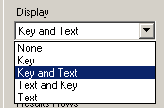
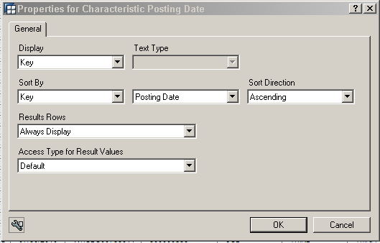
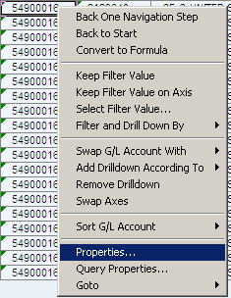

Field Properties
Choose how you wish to view the field
For instance, just fieldname, or with descriptive text
Choose to show ‘Results’ row by selected field
‘Results Rows’ are essentially ‘Subtotals’
32

Slide 33
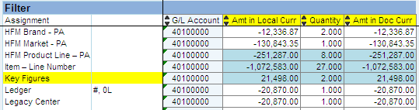
Key Figures
Key Figures are ‘measurable’ types of items in BI
Used for the Typical ‘Amount’ - but also, in this query, ‘Quantity’
Key Figures can be added or removed like any filter value by ‘Right Clicking’ when in Query Properties, or from the ‘Filter Area’
33

Slide 34
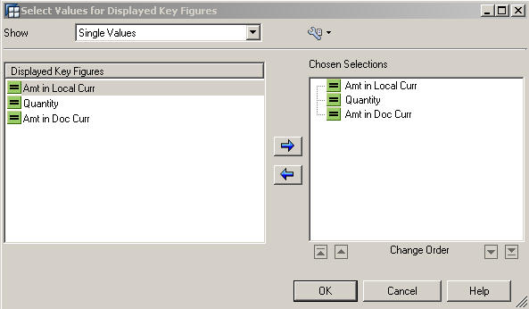
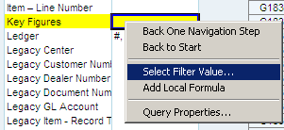
Key Figures - Changing
Right-Click ‘Key Figures’. Can be done within Query Properties, or from the Filter Area.
Choose ‘Select Filter Value’
34

Slide 35
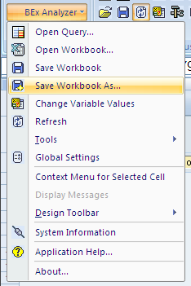
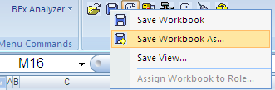
Saving a query as a Workbook
Direct in BI or as Excel
The default layout of the Query may not be exactly suited to your individual needs. After customizing, you can save it as your personal workbook in BI, for repeated use without repeated customizing.
Or
Use the ‘Disk’ menus on the toolbar OR the Dropdown from BEx Analyzer ( on the right…)

Slide 36
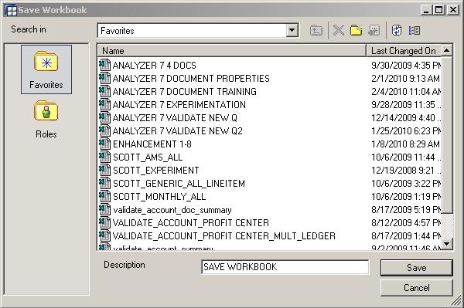
Save your Workbook (in BI)
Name the workbook in your own personal FAVORITES directory within BI.
Next session, instead of ‘Opening Query’, you can ‘Open Workbook’ containing all your personalization. Display fields, and selections.
Allows for many customized workbooks for individual needs.
36

Slide 37




Open Workbook (from BI)
As with Saving, Open from the Dropdown OR the Toolbar
CITI file
In FI, the lowest level would be Line 4 = 336,622.22

Slide 38



Save Workbook as ‘Excel’
Save the file in any normal directory (as opposed to BI directly)
Better for ‘sharing’
Notice – file format is .XLSM

Slide 39


Workbook as Excel…a note
Saving as Excel instead of as BI allows for sharing, in which case… save a Query right to Sharepoint
This is an active query saved on the SAP Finance User forum and can be run

Slide 40


Workbook …Refresh
Refresh a Workbook upon opening to establish a connection to the BI.
Refresh by:
DropDown Box
Icon
Right Click from filter

Slide 41


Data flow in SAP BI

Slide 42

Data flow in SAP BI

Slide 43


Data flow in SAP BI (multiprovider)

Slide 44
Globalization- SAP BI
Multiprovider concept in SAP BI help address time zones in building Info Cubes.
NA cube build occurs in NA timezone
LA cube build occurs in LA timezone
EU cube build occurs in EU timezone
APAC cube build occurs in APAC timezone
One common multi provider on top of all regional infocubes.

Slide 45
DW DATA BASE FLOW
PRODUCT_CODE
TIM F07190
PM300140
STG_PRODUCT_CODE
PRODUCT_MANAGER
PRODUCT_LINE
PRODUCT_MARKET
TIM F07152
PM300138
STG_PRODUCT_MANAGER
TIM F07190
PM300140
STG_PRODUCT_LINE
TIM F07152
PM300138
STG_PRODUCT_MARKET
STRATEGIC_TEAM
PMP_XREF
TIM F07152
PM300138
STG_STRATEGIC_TEAM
WEBFER TABLE
WEB_PMP_XREF
PMP
WEBFER TABLE
WEB_PMP

Slide 46
DW DATA BASE FLOW
COST
LAST_ACTUAL_COST
PRICE_ON_HAND
FUTURE_PRICE
TIM F00947
PM300129
STG_COST
?
?
STG_LAST_ACTUAL_COST
TIM F00947
PM300129
STG_FUTURE_PRICE
TIM F04970
PM300241
STG_PART_ON_HAND
PART_PRICE
TIM F00947
PM300129
STG_PART_PRICE
PART_COUNTRY
VENDOR
PRICING_CATEGORY_VALIDATION
TIM F04970
PM300144
STG_PART_COUNTRY
TIM F04970
PM300144
STG_PART_VENDOR
TIM F05857
PM300145
STG_PRICING_REMARKS
TIM F04978
PM300107
STG_VENDOR
TIM F07139
PM300142
STG_PRICING_CATEGORY_VALIDATION
VENDOR_PURCHAPM_INFO
PART_SUB_TO_XREF
TIM F04978
PM300107
STG_VENDOR_PURCHAPM_INFO
TIM F05857
PM300145
STG_PART_SUB_TO_XREF
REMAN_GROUP_1
PART_GLOBAL
PART_NOUN
WEBFER TABLE
WEB_REMAN_GRP_1
TIM F04970
PM300144
STG_PART_GLOBAL
TIM F07165
PM300238
STG_PART_LAST_PRODUCED
TIM F00947
PM300129
STG_PRICE_ROOT
TIM F00933
PM300143
STG_PART_NOUN
REMAN
REMAN_GROUP_2
REMAN_XREF
WEBFER TABLE
WEB_REMAN
WEBFER TABLE
WEB_REMAN_GRP_2
TIM F07148
PM300142
STG_REMAN_XREF

Slide 47
DW DATA BASE FLOW
FINANCIAL_REGION
WEBFER TABLE
WEB_FINANCIAL_REGION
FINANCIAL_MARKET
WEBFER TABLE
WEB_FINANCIAL_MARKET
COUNTRY
FINANCIAL_MKT_XREF
TIM?
?
STG_COUNTRY
?
PARTS_CREDIT_TERMS
STATUS
WEBFER TABLE
WEB_PARTS_CREDIT_TERM
WEBFER TABLE
WEB_STATUS

Slide 48
DW DATA BASE FLOW
GLOBAL_REGION
WEBFER TABLE
WEB_GLOBAL_REGION
REGION
WEBFER TABLE
WEB_REGION
SUB_REGION
WEBFER TABLE
WEB_SUB_REGION
SUB_REGION_XREF
WEBFER TABLE
WEB_SUB_REGION_XREF
ISC
TIM F04972
PM300101
STG_ISC
ISC_ENTITY
TIM F04972
PM300101
STG_ISC_ENTITY

Slide 49
DW DATA BASE FLOW
EQUIPMENT_GRP
HOME_EXPORT
WEBFER TABLE
WEB_EQUIPMENT_GROUP
WEBFER TABLE
WEB_HOME_EXPORT
FUTURE_LEVEL_PART_PRICE
PROGRAM_CORE_BASE
TIM F00947
PM300129
STG_FUTURE_LEVEL_PART_PRICE
TIM F07152
PM300138
STG_PROGRAM_CODE_BASE
CAMPAIGN_CODE_BASE
PROGRAM
PROGRAM_PART_PRICE
TIM F07152
PM300138
STG_CAMPAIGN_CODE_BASE
TIM F00937
PM300141
STG_PROGRAM
TIM F00947
PM300129
STG_PROGRAM_PART_PRICE
TRADE_FAIR_XREF
PROMO_GRP_XREF
TERMS_AND_DISCOUNT
WEBFER TABLE
WEB_TRADE_FAIR_XREF
WEBFER TABLE
WEB_PROMO_GRP_CATEGORY
WEB_PROMO_GRP_CAMPAIGN
WEB_PROMO_PROMO_PROGRAM
TIM F00937
PM300141
STG_TERMS_AND_DISCOUNTS
TRADE_FAIR
PROMO_GRP
WEBFER TABLE
WEB_TRADE_FAIR
WEBFER TABLE
WEB_PROMO_GRP

Slide 50
COOL DATA BASE FLOW
ABM_ASBDM_PBD
DEALER_TYPE
WGS MISC TBLS F01000
COOL9504
STG_ABM
WGS MISC TBLS F01000
COOL9504
STG_DEALER_TYPE
WG_DEALER
SUB_LOCATION
GDD F01850
COOL9501
STG_GLOBAL_DEALER
TIM F04974
PM300102
STG_TIM_SUBLOCATION
GDD F01850
COOL9502
STG_GLOBAL_SUBLOCATION
GDD F01850
COOL9502
SUBLOCATION_XREF
CBU_CBM
BRAND
WGS MISC TBLS F01000
COOL9504
STG_CBM
WGS MISC TBLS F01000
COOL9504
STG_BRAND
GM_BM
BRAND_XREF
CAM
WGS MISC TBLS F01000
COOL9504
STG_GM
WEBFER TABLE
WEB_BRAND_XREF
TIM F04970
PM300101
STG_CAM
SALES_AREA
BRAND_GROUP
CAM_REGION
WEBFER TABLE
WEB_SALES_AREA
WEBFER TABLE
WEB_BRAND_GROUP
WEBFER TABLE
WEB_CAM_REGION
COMPANY_XREF
COMPANY
WEBFER TABLE
WEB_COMPANY_XREF
WEBFER TABLE
WEB_COMPANY

Slide 51
DW DATA BASE FLOW
CUSTOMER_GROUP
SHIP_TYPE
ORDER_OPTION
??
WEBFER TABLE
WEB_SHIP_TYPE
WEBFER TABLE
WEB_TRADE_FAIR_ORDER_OPTION
CUSTOMER_TYPE
ORDER_CHANNEL
ORDER_STATUS
WEBFER TABLE
WEB_CUSTOMER_TYPE
?
?
STG_CUSTOMER_TYPE
WEBFER TABLE
WEB_ORDER_CHANNEL
WEBFER TABLE
WEB_TRADE_FAIR_ORDER_STATUS
ORDER_GRP
WEBFER TABLE
WEB_ORDER_GROUP
CUSTOMER_TYPE_XREF
ORDER_SUB_GRP
WEBFER TABLE
WEB_CUST_TYPE_XREF
WEBFER TABLE
WEB_ORDER_SUB_GROUP
ORDER_TYPE
WEBFER TABLE
WEB_ORDER_TYPE

